Slide 1
HealthChain Project: An Overview
This project demonstrates a complete web application. It uses popular technologies for its user interface, server, and data storage.

Slide 2

Problem & Motivation
Fragmented Health Information
Need for a Secure Platform
Health information is spread out among hospitals, pharmacies, and patients.
We need a safe and easy-to-use platform for people to handle their health records, prescriptions, and appointments.
Goal: Real-World Example
Our goal: Create a clear, working example that shows how this would work in real life, with useful features.

Slide 3




Why MongoDB + React?
MongoDB: Flexible Data Storage
MongoDB is great for storing all kinds of patient information, like medical history and prescriptions, because it's so flexible.
Its flexible design helps us build and test new features quickly.
React: Engaging User Interface
React makes the app interactive and look great. It lets us reuse parts and add smooth animations, which speeds up development.
Seamless Integration
Together, they help us create a modern, growing app demo that works well.

Slide 4
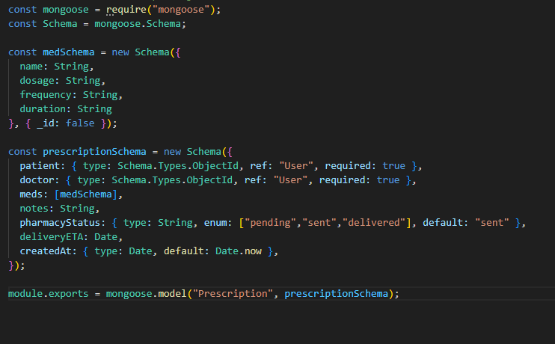

Slide 5




How it's Built (Overview)
React App (Frontend)
Node.js Server (Backend)
The React app is what users see and interact with. It has pages for home, choosing a role, logging in, patient details, and an "About" section.
A Node.js server runs behind the scenes. It handles tasks like user logins, patient information, prescriptions, and appointments.
MongoDB Database (Data Storage)
Secure Login Methods
All important data is stored in a MongoDB database. This includes user accounts (for patients, doctors, and pharmacies), medical records, and prescriptions.
We use secure login methods to protect your data when the app talks to the server.

Slide 6
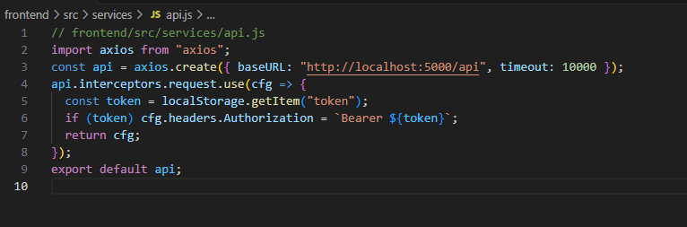

Slide 7





Key Features
Secure Login
Comprehensive Patient Profiles
Medical History & Prescriptions
Patients, doctors, and pharmacies can access the system securely, protecting sensitive health information.
Detailed profiles include personal details, allergies, emergency contacts, current medications, and health status.
Access full medical history and current prescriptions, with real-time updates on pharmacy delivery.
Doctor Assignment & Contact
Intuitive User Experience
Easily assign main and assistant doctors, with quick contact options for seamless communication.
A modern, user-friendly design with smooth animations ensures a great experience on any device.

Slide 8





Key Points on Database Design
Unified User List
We store details for patients, doctors, and pharmacies all in one place, simplifying information connections.
Linked Patient Records
A patient's medical history, current health, and prescriptions are directly connected to their doctors' profiles.
Quick Demo Setup
We use pre-made patient, doctor, and prescription data to quickly demonstrate the system's capabilities.
Key Benefits
This design makes information easier to search, allows the system to scale, and simplifies new data additions.

Slide 9




UI / UX & Polish
Sleek & Modern Design
Dynamic Animations
A sleek design with smooth color shifts and modern, transparent elements for a professional feel.
Smooth animations for elements appearing, mouse interactions, and moving backgrounds.
User-Friendly & Responsive
Shareable Content
Easy-to-use design with clear text, adjusts well to any screen size, and doctor profiles that stay in view.
Great for sharing on LinkedIn, with sections ready for screenshots (like user profiles, prescription lists, and doctor details).

Slide 10
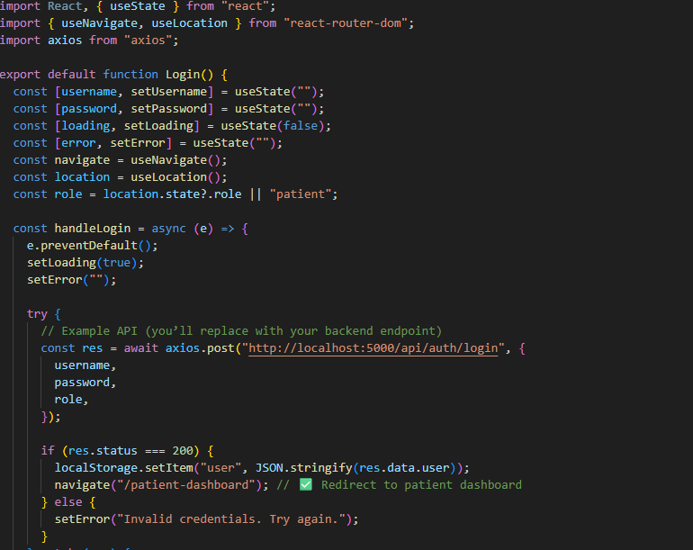

Slide 11

Node.js: A Modern Web Tool
Node.js for Enhanced Animations
Why Node.js Excels Over HTML+CSS
Node.js, particularly with frameworks like React, facilitates complex, fluid animations difficult to achieve with traditional HTML/CSS. Popular animation tools include:
Faster Load Times: Node.js pre-renders pages, leading to quicker loading and better SEO than static HTML/CSS.
Framer Motion: Simplifies great UI animations in React.
Modular Development: With tools like React, Node.js enables building with reusable components, simplifying code management.
React Spring: Creates physics-based, natural-looking animations.
Lottie: Integrates After Effects animations for web/app.
Vast Code Library (npm): Access to npm's massive collection of pre-written code speeds up feature development significantly.
Real-time Data Handling: Ideal for apps needing instant updates, as Node.js efficiently manages many simultaneous tasks.

Slide 12
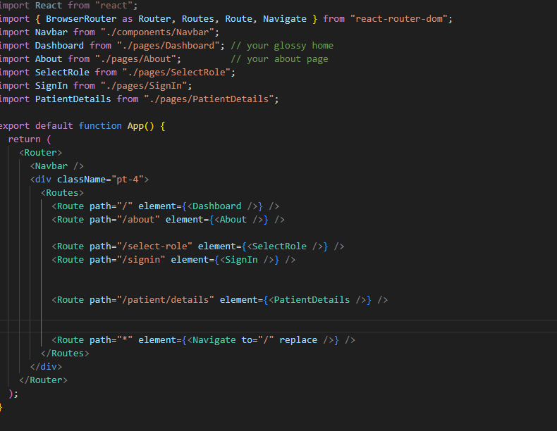

Slide 13
